Slide 1
Beam with spring support
Cantilever with a spring at one end
w
A
B

Slide 2
Beam with spring support
Replace the spring with a force
w
A
B
P

Slide 3
Beam with spring support
We will use superposition
We will split the problem into two problems we have solved before
w
A
B
A
B
P

Slide 4
Beam with spring support
For the first problem the solutions are as shown below (recall the beam AB of the hinged beam problem)
w
A
B

Slide 5
Beam with spring support
For the second problem the solutions are as shown below (we have to substitute –P for P the cantilever with upward point load at tip solved earlier)
A
B
P

Slide 6
Beam with spring support
Adding the two solutions will give us the solution for the problem shown below
w
A
B
P

Slide 7
Beam with spring support
Let us now look at the spring alone
The spring is being compressed by the force P
Hence the spring gets compressed by an amount Δ
This must also be the same as the deflection of the tip of the beam. Hence
P
B

Slide 8
Beam with spring support
The deflection at the tip is
The compression of the spring is

Slide 9
Beam with spring support
Equating the deflection of the tip to the compression of the spring will let us solve for P

Slide 10
Beam with spring support
We can now substitute this expression for P and get the solution for the entire problem

Slide 11
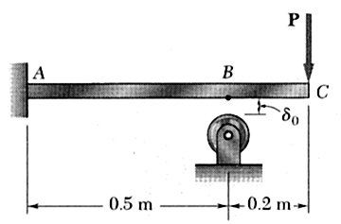
Beam with a gapped support
A gap δ₀ is present between the cantilever beam ABC and the support at B at B under no load. Find the deflection at C after the load P is applied.
a
b

Slide 12
Beam with a gapped support
This is again a problem in two parts. If P is not large enough to literally bridge the gap, then there are no worries. Deflection at C will be the usual tip deflection for a cantilever. We can also, if required calculate the deflection at B due to P and subtract that from δ₀ to obtain the new gap at B.
a
b

Slide 13
Beam with a gapped support
We will consider the case when P is large enough to cause B to come in contact with the support.
a
b

Slide 14
Beam with a gapped support
For this we need to solve the first problem anyway, because we will need to know the deflection at C when the beam just touches B without causing any contact force.
a
b

Slide 15
Beam with a gapped support
We also need to understand the phenomena clearly. The force at the tip increases slowly from 0 to a value Q, when there is bare minimum contact at B. Then the force increases slowly to a value P till the final equilibrium shape is reached.
We are not dealing with quick instantaneous loading
The theories that we usually use in this subject are not valid for such rapid loading. In all problems we have solved so far in mechanics, the inherent assumption is that the load increases very slowly to its final value that is given in the text of the problem

Slide 16
Beam with a gapped support
For a cantilever beam with a load Q at the tip we know
At B, x=a. Hence
a
b

Slide 17
Beam with a gapped support
Since
We can find the force Q
a
b

Slide 18
Beam with a gapped support
So deflection at C due to the action of this force Q is
a
b

Slide 19
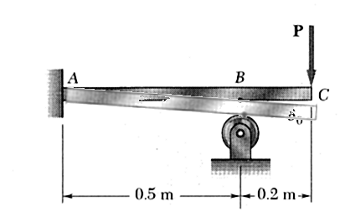
Beam with a gapped support
Let us now consider what happens when the force goes beyond Q to a value P=P’+Q
a
b

Slide 20
Beam with a gapped support
We now re draw the diagram of the beam in its final state replacing the support by a reaction R_{B}
R_{B}
a
b

Slide 21
Beam with a gapped support
We can split this problem again into two simpler problems
A cantilever beam loaded at the tip C by a force P=P’, where P’ is the extra force added after deformation by Q
A cantilever beam with overhang BC loaded at B by a force R_{B}
R_{B}
a
b

Slide 22
Beam with a gapped support
However we will choose to do this by the usual process.
So we start by drawing the FBD.
M_{A}
R_{B}
R_{A}
a
b

Slide 23
Beam with a gapped support
We write down the equations of static equilibrium.
Since there are 3 unknown reactions and 2 equations the problem is statically indeterminate
M_{A}
R_{B}
R_{A}
a
b

Slide 24
Beam with a gapped support
There are two domains AB and BC.
We consider AB first
y, v
M_{A}
M
x
R_{B}
R_{A}
V
a
b

Slide 25
Beam with a gapped support
Apply flexure equation
y, v
M_{A}
M
x
R_{B}
R_{A}
V
a
b

Slide 26
Beam with a gapped support
Apply boundary conditions for this domain by considering the slope and deflection at A
The solution is
y, v
M_{A}
M
x
R_{B}
R_{A}
V
a
b

Slide 27
Beam with a gapped support
We consider BC next
y, v
M_{A}
M
x
R_{B}
R_{A}
V
a
b

Slide 28
Beam with a gapped support
Apply flexure equation
y, v
M_{A}
M
x
R_{B}
R_{A}
V
a
b

Slide 29
Beam with a gapped support
Apply boundary conditions for this domain by considering the slope and deflection at B
y, v
M_{A}
M
x
R_{B}
R_{A}
V
a
b

Slide 30
Beam with a gapped support
Considering the slope at B
y, v
M_{A}
M
x
R_{B}
R_{A}
V
a
b

Slide 31
Beam with a gapped support
Considering the deflection at B
y, v
M_{A}
M
x
R_{B}
R_{A}
V
a
b

Slide 32
Beam with a gapped support
Solution

Slide 33
Beam with a gapped support
Considering the deflection at B
Static equilibrium equations
y, v
M_{A}
M
x
R_{B}
R_{A}
V
a
b

Slide 34
Beam with a gapped support
We can solve for the unknown reactions
y, v
M_{A}
M
x
R_{B}
R_{A}
V
a
b

Slide 35
Beam with a gapped support
We can solve for the unknown reactions
y, v
M_{A}
M
x
R_{B}
R_{A}
V
a
b

Slide 36
Beam with a gapped support
We can solve for the unknown reactions
y, v
M_{A}
M
x
R_{B}
R_{A}
V
a
b

Slide 37
Beam with a gapped support
Deflection at C after contact due to a force P’=P-Q is therefore

Slide 38
Beam with a gapped support
Deflection at C after contact due to a force P-Q

Slide 39
Beam with a gapped support
Total deflection at C after contact is therefore

Slide 40
Beam on Beam

Slide 41
L shaped beam

Slide 42
L shaped rod

